Slide 1
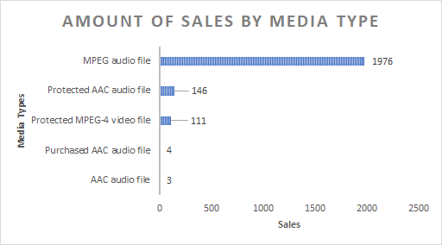
Sales by Media Type
<visualization>
We can see that without question MPEG audio file is the preferred media type, covering almost 90% of the total sales.
No other format gets even closer to the amount of sales that MPEG audio files have.
Not even adding up the different types of ACC audio files.

Slide 2
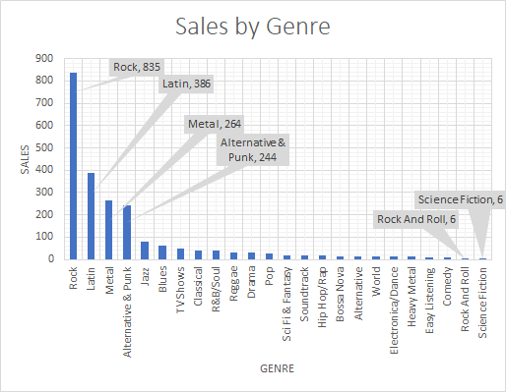
Sales by Musical Genre
<visualization>
The most sold Genre is Rock by far, followed by Latin with less than half of the sales.
A slow decrease can be seen between the first genres, that later turns into a very little amount of sales per genre until the last 2 with 6 sales only.

Slide 3
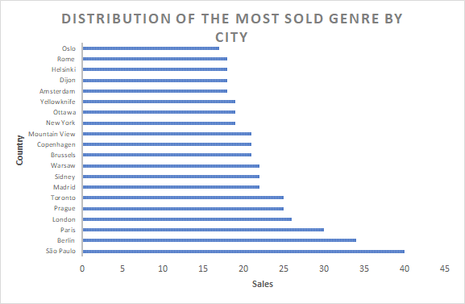
Sales of the most sold Genre by Country
As seen in the previous slide, Rock was the genre with more sales, and here we can see the distribution of those sales among the top 20 cities.
Although it’s clear that Sao Paulo has the biggest consumption of this genre, Paris and Berlin are also very close. Overall, the consumption is well distributed.
<visualization>

Slide 4
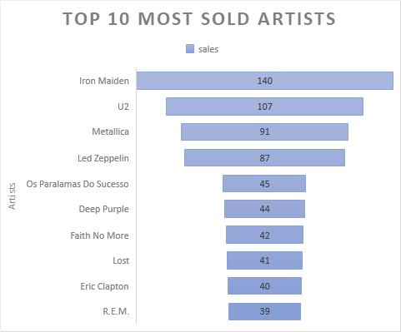
Top 10 most sold Artists
<visualization>
The most sold artist is Iron Maiden with 140 sales, followed by U2 with 107.
After the first 4 artists the sales decrease to 45 and start decreasing in a slow pace, being the last artist R.E.M with 39 sales only.

